Slide 1

Poll
What’s your biggest focus for improving outbound right now?
From Intent Signal to Booked Meeting
Notes:
ALYSSA to call out POLL to open the webinar
ADJI to launch POLL

Slide 2
From Intent Signal to Booked Meeting
WEBINAR
Notes:
ALYSSA

Slide 3
Today’s agenda
Housekeeping
Meet the speakers
Chapter 1: Find the right prospects
Chapter 2: Engage consistently
Chapter 3: Reach them safely
Live Q&A
From Intent Signal to Booked Meeting
‹#›
Notes:
ALYSSA

Slide 4
Housekeeping
YES
?
You’ll get a recording!
Put questions into the Q&A
Check your email within 2 days
Type your questions into the “Q&A” tab instead of the chat
From Intent Signal to Booked Meeting
Notes:
ALYSSA
We are recording the webinar. You’ll get it via email.
If you have questions, drop them in the Q&A tab. We’ll answer as many as we can throughout the webinar.

Slide 5

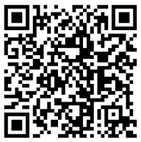
SCAN OR GO TO: apollo.io/community
Join the Apollo
Community
in Slack
From Intent Signal to Booked Meeting
Notes:
ALYSSA
Scan to join the Community or head to apollo.io/community. (Link will scroll via ticker too)

Slide 6
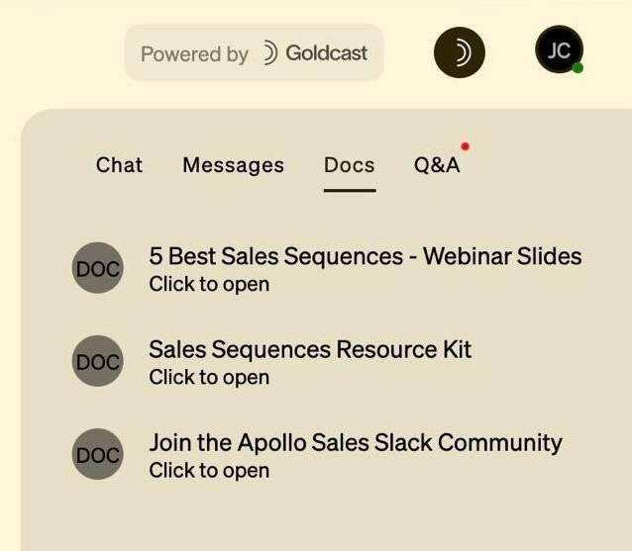
LOOK IN THE DOCS TAB
Resources
From Intent Signal to Booked Meeting
Notes:
ALYSSA
You can find resources linked in the Docs tab on your right. That’s also where you can chat and ask questions in the Q&A.

Slide 7

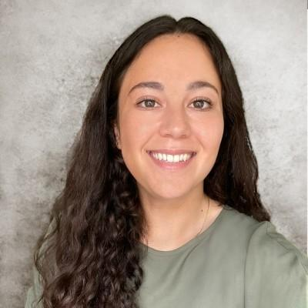
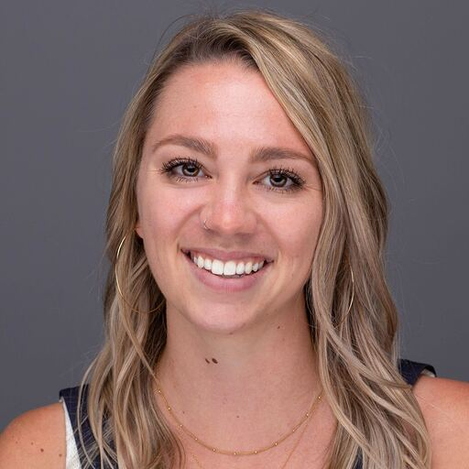
Speakers
Radu Vaduva
Layla
Jaffe
Alyssa Haeussler
Senior Solutions Consultant II
Senior Outbound Sales Manager
Product Marketing Manager
From Intent Signal to Booked Meeting
Notes:
ALYSSA to welcome speakers and each will give a short intro

Slide 8



Outbound that’s less ‘cold outreach’ and more ‘perfect timing’
Find the right prospects
AI Assistant
Lead Scoring
Buying Intent
From Intent Signal to Booked Meeting
Notes:
LAYLA to present and then pass to Radu to demo

Slide 9

LET’S SEE IT
IN ACTION
WHAT’S NEW IN APOLLO
Notes:
[Radu to demo Live]

Slide 10



Take action to move pipeline forward
Engage consistently
Sequences
Tasks
Dialer
From Intent Signal to Booked Meeting
Notes:
LAYLA to present and then pass to Radu to demo

Slide 11
LET’S SEE IT
IN ACTION
WHAT’S NEW IN APOLLO
Notes:
[Radu to demo Live]

Slide 12

Make sure emails actually reach your prospects
Reach them
safely
Deliverability Suite
From Intent Signal to Booked Meeting
Notes:
LAYLA to present and then pass to Radu to demo

Slide 13
LET’S SEE IT
IN ACTION
WHAT’S NEW IN APOLLO
Notes:
[Radu to demo Live]

Slide 14
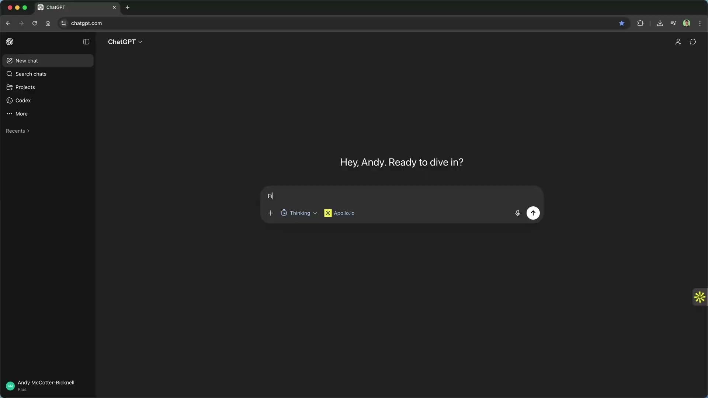
Apollo is now in ChatGPT
Search for people or companies, enrich data, and more. Setup takes 2 minutes.
AVAILABILITY
All users (free and paid) can access the ChatGPT app.
USAGE & LIMITS
Usage is subject to your Apollo plan's API limits and company domain verification.
ACCESS
Go to the Apollo app page or search for “Apollo” in the ChatGPT app directory (located under “Apps” in the sidebar), visit Apollo’s app listing, and connect via OAuth (no API keys). Or click here.
WHAT’S NEW IN APOLLO
Notes:
ALYSSA
We’re excited that Apollo is now available directly inside ChatGPT.
Users can search for people and companies, enrich data, and access Apollo’s core capabilities without leaving ChatGPT. Setup is quick—just about two minutes through a secure OAuth connection, with no API keys needed.
The app is available to all ChatGPT users, free and paid, with usage based on your Apollo plan’s API limits and company verification.
To get started, simply search for Apollo in the ChatGPT app directory or visit the Apollo app page and connect your account.

Slide 15
Want to speak to Apollo’s sales team?
Request a demo
From Intent Signal to Booked Meeting
Notes:
ALYSSA to call out POLL
“Quick poll for everyone—if you’d like to speak directly with Apollo’s sales team, this is the easiest way to let us know.
Whether you’re interested in learning more, exploring solutions for your team, or discussing custom options, we’d love to connect.
Go ahead and respond, and our team can follow up with the right resources after the webinar.”
ADJI to launch POLL

Slide 16
Q&A
From Intent Signal to Booked Meeting
Notes:
ALYSSA to moderate questions

