Slide 1

Ice Breaker
What’s one task you’d want AI to take off your plate this week? (e.g., list building, outreach emails)
How to Book 2.3x’s Meetings in the First 14 Days
Notes:
JAMES
Hey everyone, welcome to How to Book 2.3x’s Meetings in the First 14 Days — thanks for spending part of your day with us.
I’m James, one of the instructors here at Apollo Academy, and I’m really excited to dig into how Apollo’s AI Assistant can actually help you book more meetings in less time, not just write clever-sounding emails.
To get us warmed up, drop two things in the chat for me:
Where you’re joining from, and
Your role (SDR, AE, RevOps, Marketing, Founder, etc.).
As those roll in, think about this: if AI could take one painful GTM task off your plate this week — building lists, writing first-touch emails, cleaning up CRM data, you name it — what would you choose? Go ahead and throw that in the chat too.

Slide 2
How to Book 2.3x’s Meetings in the First 14 Days
WEBINAR
Notes:
JAMES

Slide 3
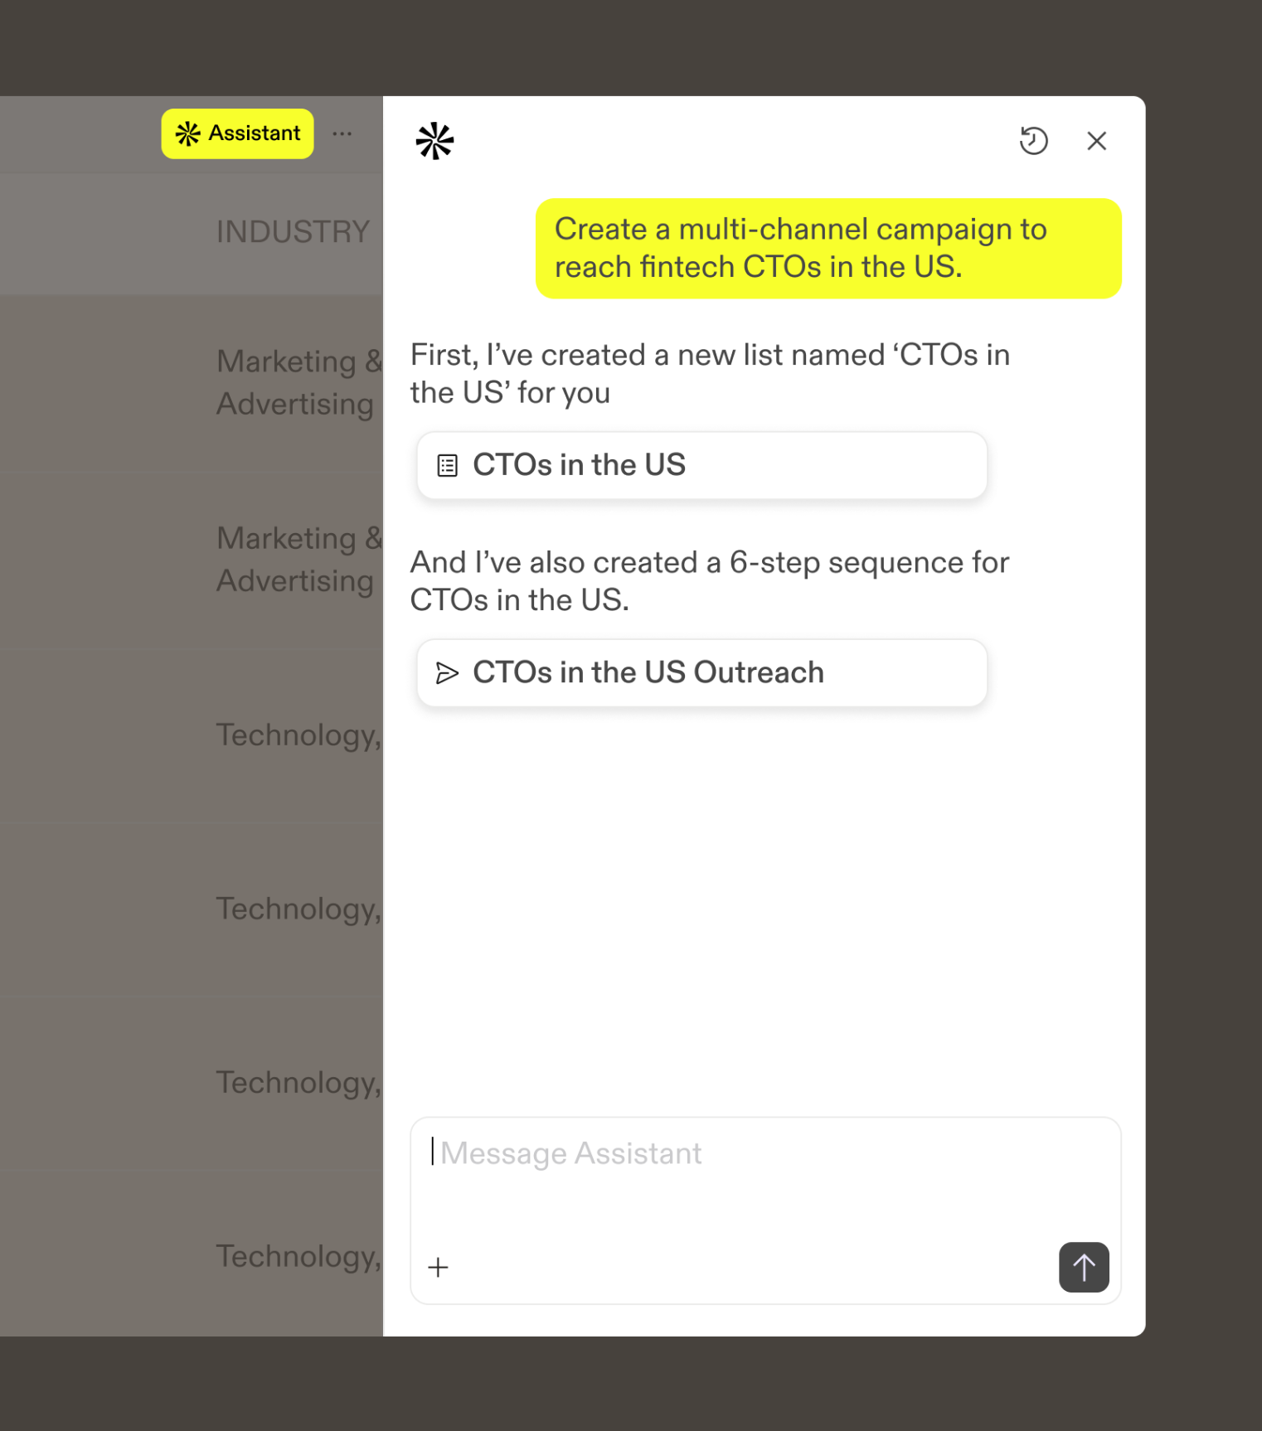




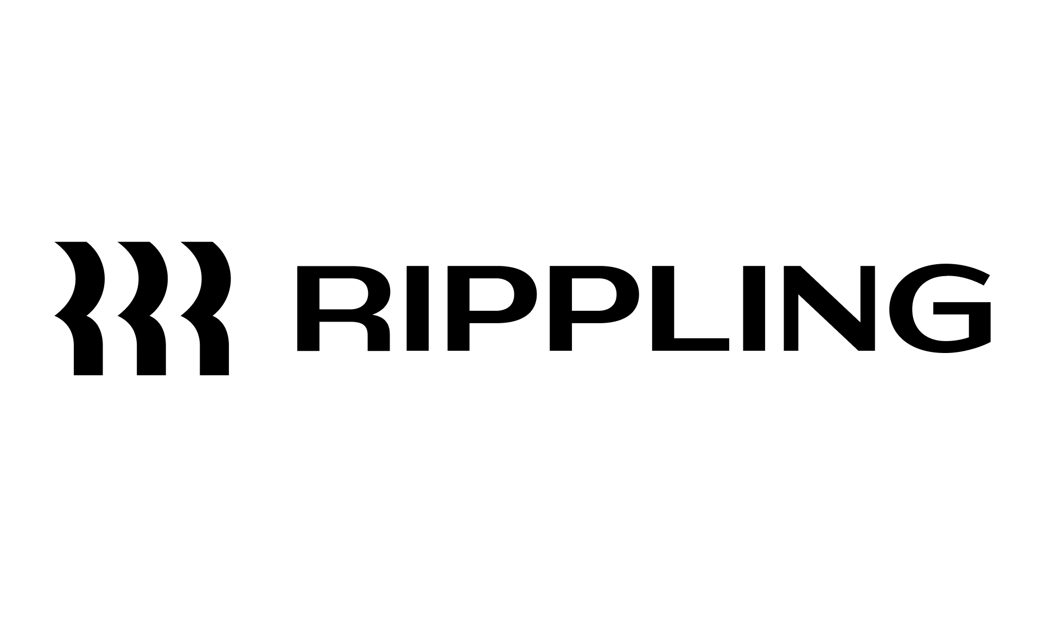
The End-to-End AI Sales Platform
Trusted by 3M users across 500,000 companies
How to Book 2.3x’s Meetings in the First 14 Days
Notes:
JAMES
“This is sponsored by Apollo” - the world’s only end-to-end AI Sales Platform…
Call out many of you are users and if you’re not, you can create an account for free at apollo.io.

Slide 4
Housekeeping
YES
?
You’ll get a recording!
Put questions into the Q&A
Check your email within 2 days
Type your questions into the “Q&A” tab instead of the chat
How to Book 2.3x’s Meetings in the First 14 Days
Notes:
JAMES
We are recording the webinar. You’ll get it via email.
If you have questions, the best chance of getting them answered is to drop them in the Q&A tab

Slide 5

Really. No Spam.
Don’t be rude.
(This includes dropping your Linkedin.
You can connect in our Sales Community.)
We will delete messages and ban offenders at our discretion.
How to Book 2.3x’s Meetings in the First 14 Days
Notes:
JAMES
Don’t spam the chat. This isn't a good forum for you to try and sell your product or service. Don’t be offensive or rude. We will kick you out of the event.

Slide 6
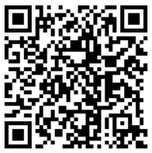
SCAN OR GO TO: apollo.io/community
Join the Apollo Community in Slack
How to Book 2.3x’s Meetings in the First 14 Days
Notes:
JAMES
Scan to join the Community or head to apollo.io/community. (Link will scroll via ticker too)

Slide 7
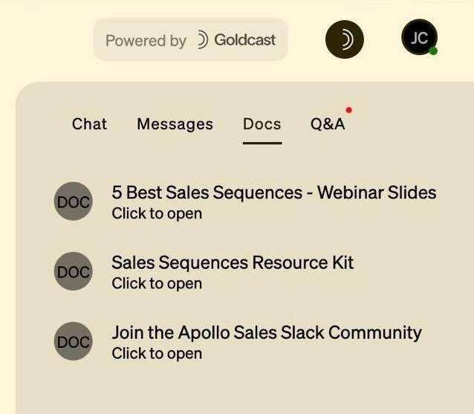
LOOK IN THE DOCS TAB
Resources
How to Book 2.3x’s Meetings in the First 14 Days
Notes:
JAMES
You can find resources linked in the Docs tab on your right. That’s also where you can chat and ask questions in the Q&A.

Slide 8
Safe Harbor Statement
Our forward-looking statement.
This document may contain forward-looking statements that involve risks, uncertainties, and assumptions. All statements other than statements of historical fact could be deemed forward-looking statements, including any statements concerning new features, enhancements, or upgrades to our existing applications or plans for future applications; statements relating to the expected performance or benefits of our offerings; statements about current or future economic conditions; and any other statements of expectation or belief. Because forward-looking statements relate to the future, they are subject to inherent uncertainties, risks, and changes in circumstances that are difficult to predict and many of which are outside of our control. Our actual results and financial condition may differ materially from those indicated in the forward-looking statements, and therefore you should not rely on any forward-looking statements that we may make.
The risks and uncertainties referred to above include, but are not limited to, our history of losses and expectations as to future losses, limited operating history, competition, management of growth, development of the market for enterprise cloud computing, market acceptance of our applications, breaches of our security measures, compliance with global laws and regulations, risks associated with maintaining a global business and global economic conditions, fluctuations in our operating results, interruptions or delays in the provision of our services, and risks associated with selling to larger enterprise customers.
Apollo.io assumes no obligation for, and does not intend to update, any forward-looking statements.
Any unreleased services, features, functionality, or enhancements referenced in an Apollo.io document, roadmap, blog, website, press release, or public statement that are not currently available are subject to change at Apollo.io’s discretion and may not be delivered as planned or at all. Customers who purchase our applications should make their purchase decisions based upon features and functions that are currently available.
WHAT’S NEW IN APOLLO
Notes:
“Quick Safe Harbor reminder: we may discuss roadmap items and future enhancements. These are subject to change, and we don’t make commitments on unreleased features.
Please make decisions based on what’s generally available today.”
Alright — now that legal is happy, let’s get started.
LOVE

Slide 9
Today’s agenda
Housekeeping
Chapter 1: Meet AI Assistant
Chapter 2: Live Demo From Day 0
Live Q&A
How to Book 2.3x’s Meetings in the First 14 Days
‹#›
Notes:
JAMES

Slide 10
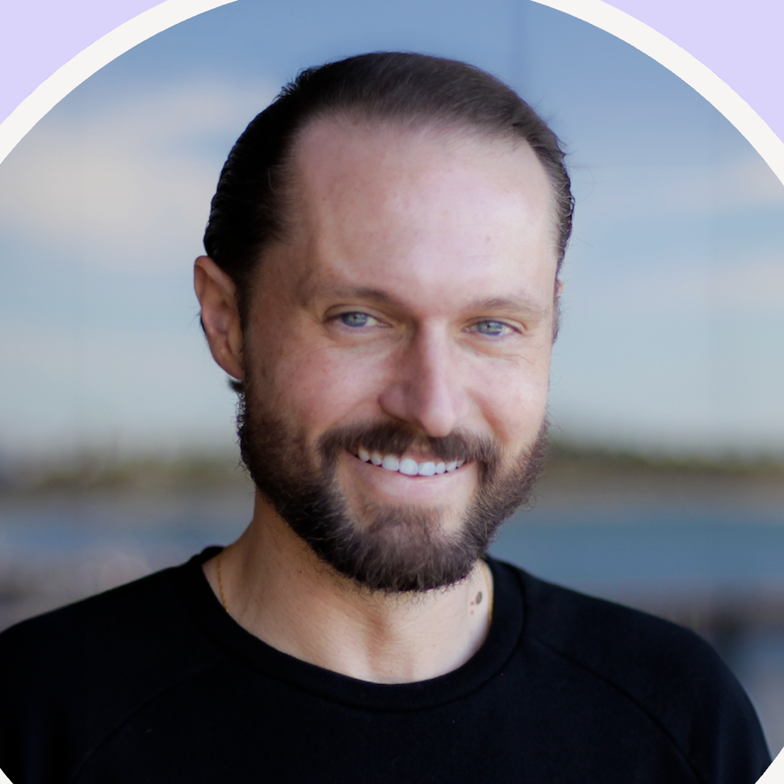
Speakers
James O'Sullivan
Apollo Academy Instructor
How to Book 2.3x’s Meetings in the First 14 Days
Notes:
James to welcome speakers on stage to give intro
Jeffrey to stay on stage
—-
Hey everyone, I'm Jeffrey - I'm a Group Product Manager here at Apollo, and I get to work on a lot of the data and enrichment capabilities you'll see today. Really excited to be here with you all.
Next, I want to introduce Mike, who's Founder at ScaledRev, to join us as well.

Slide 11
Meet Our
AI Assistant
Chapter 1:
How to Book 2.3x’s Meetings in the First 14 Days
Notes:
Before we dive in, I just want to say - I know a lot of us are in the trenches every day trying to hit pipeline targets, keep CRM clean, and make sure teams have the data they need to actually do their jobs.
This is not easy esp. when the effective GTM plays are evolving super fast. This is what exactly we're gonna talk about.

Slide 12
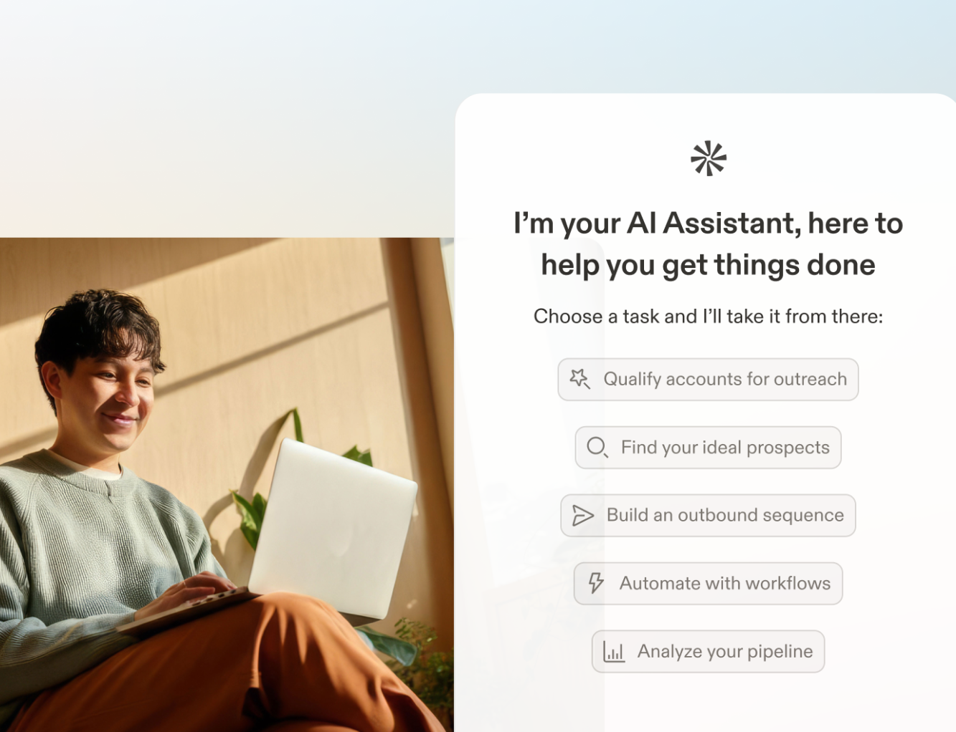
Meet Apollo’s AI Assistant
It closes the execution gap by doing real work inside Apollo.
WHAT IT IS
An in-product GTM helper that turns your request into real work across Apollo.
Do more in fewer steps
Outputs that match your context
Guidance in your workflow
WHAT’S NEW IN APOLLO
Notes:
Fewer steps: Build lists, run research, enrich records, create sequences, and pull insights without stitching steps together.
More usable outputs: Uses your Apollo workspace context (product, audience, messaging) so drafts are closer to ready-to-send with less rewriting.
Stays in your flow: Appears where you already work with suggested next steps, plus previews and confirmations before anything changes.

Slide 13
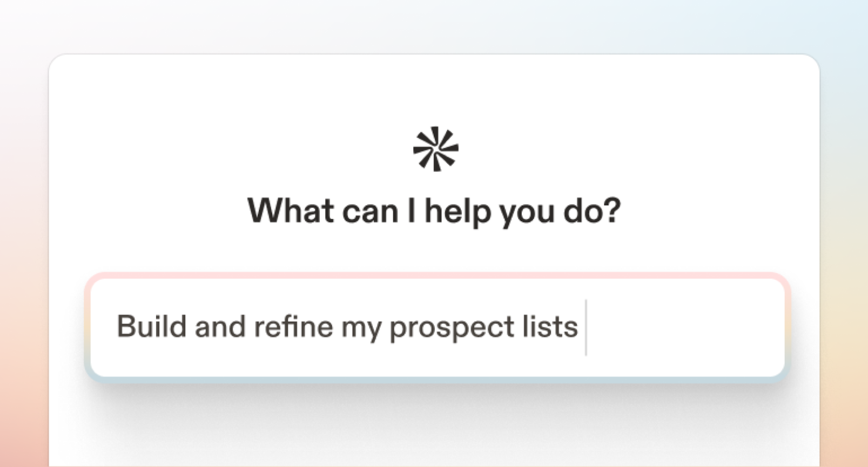
The AI Assistant is available to all
The AI Assistant is GA
Research, build, and ship GTM work in one flow.
Research, build, and ship GTM work in one flow.
Availability: All users (free and paid) can access the AI Assistant as an introductory offer.
AVAILABILITY
All users (free and paid) can access the AI Assistant as an introductory offer.
Usage + limits:
Paid plans: unlimited chats/messages
Free plan: 5 chats per billing cycle, 10 messages per chat
USAGE & LIMITS
Paid plans: unlimited chats/messages
Free plan: 5 chats per month, 10 messages per chat
Credits: The Assistant itself doesn’t cost credits. Some actions you run through it do (e.g. enrichment, AI Research, etc.).
CREDITS
The Assistant itself doesn’t cost credits. Some actions you run through it do (e.g. enrichment, AI Research, etc.).
WHAT’S NEW IN APOLLO

Slide 14
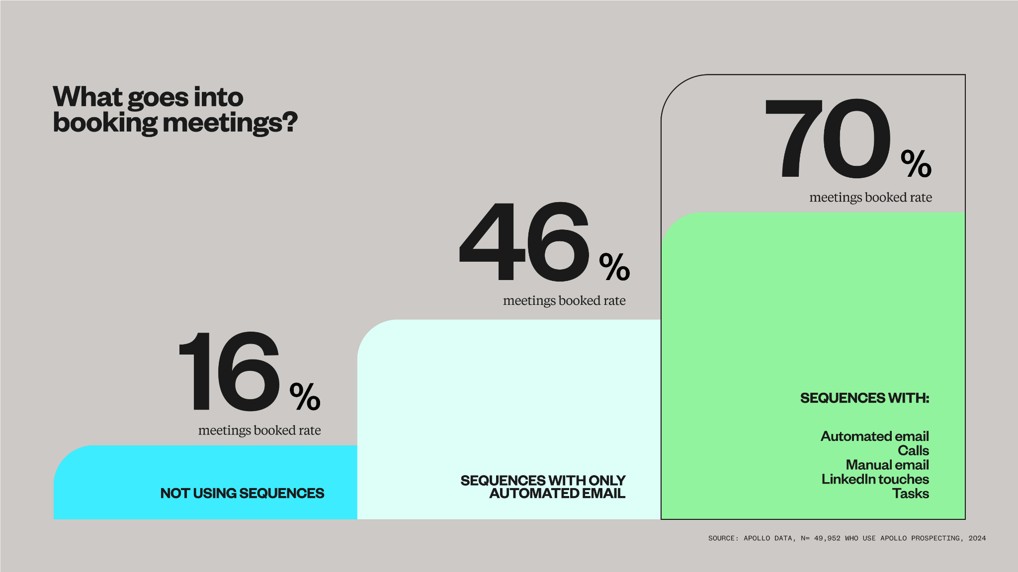
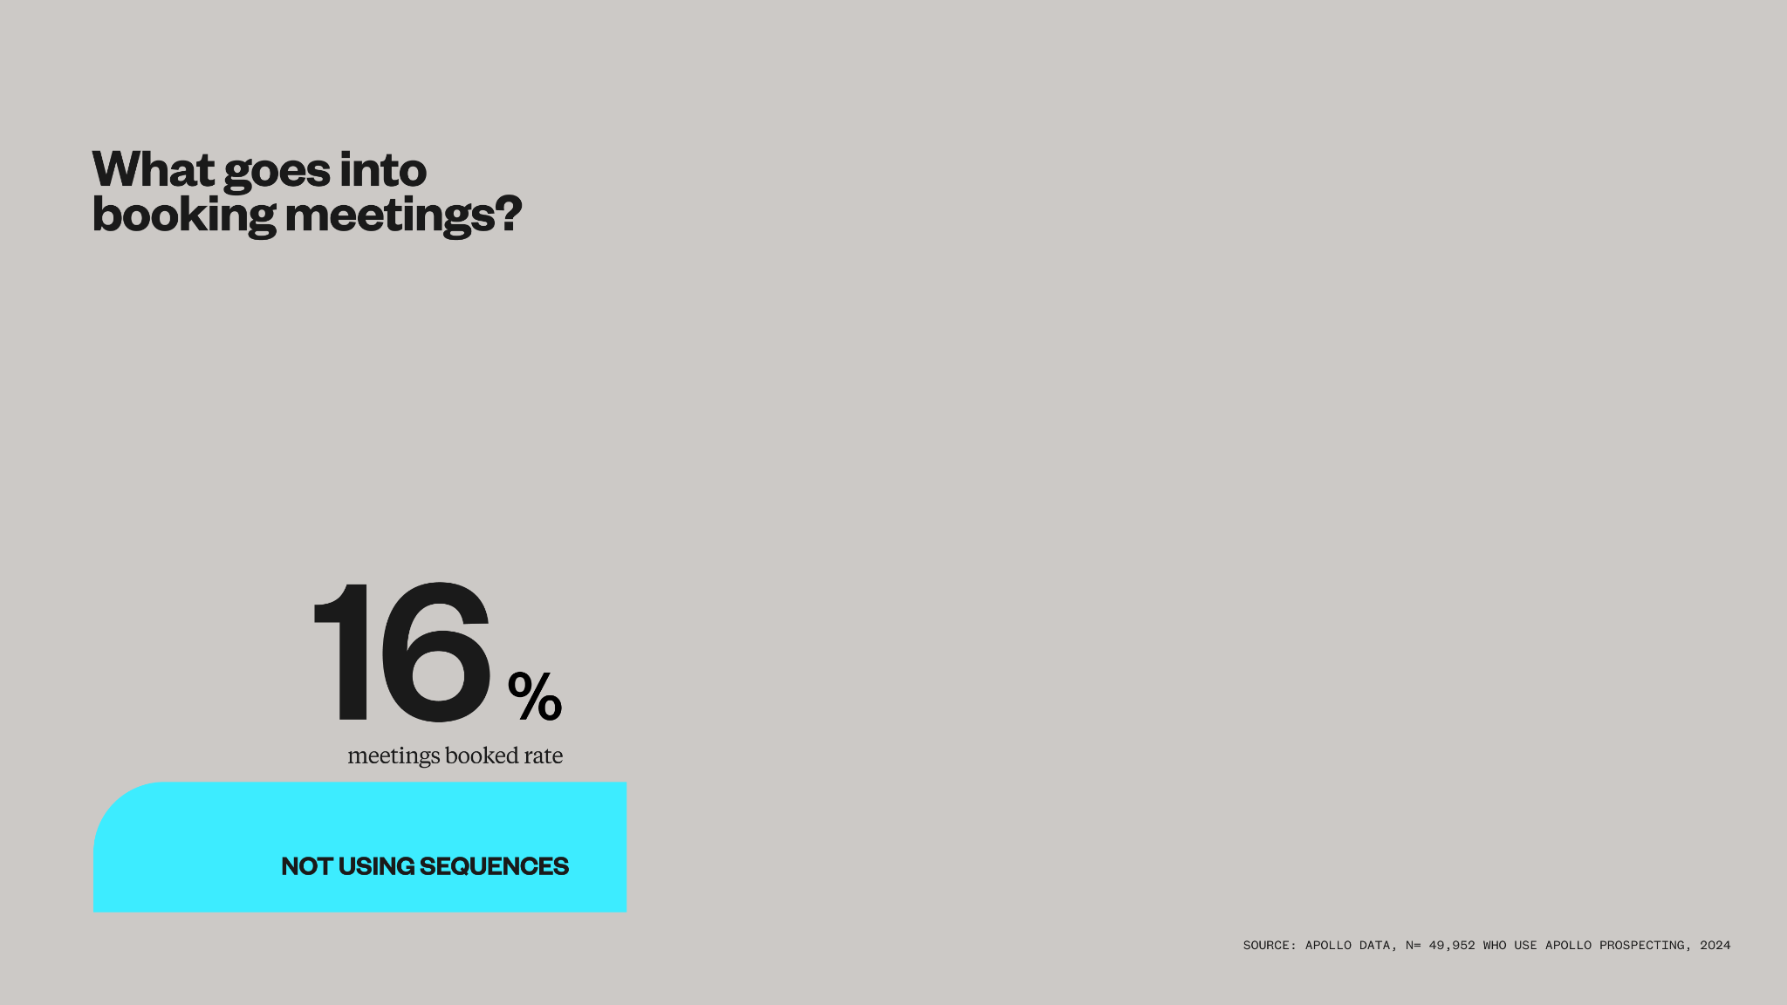
What goes into booking meetings?
* Top 1% of sellers
70% (4x)
meetings booked rate
Sequences with:
Automated email
Calls
Manual email
LinkedIn touches
Tasks
meetings booked rate
46% (3x)
16%
meetings booked rate
Sequences with only automated email
Not using sequences
Source: Apollo Data
Notes:
And we know what works. We’re sitting on a decade of GTM activity and can see what best practices are. In fact, in a study of almost 50K Apollo users, we found the best practices of what goes into booking meetings. We compared user groups across a 30 day period, to see who was best at booking meetings..
The people who only send out a single email, scatter shot, had the lowest meeting booked rate… only 16% of them are booking meetings
The people who at least create an email sequence, following up a couple times, half of them booked meetings.
The people who reach out and follow up across multiple channels book meetings 70% of them were booking meetings.
But we don’t gatekeep here. Our mission is to make GTM accessible for all. Because we know what works, we can use our AI platform to automate that for you

Slide 15
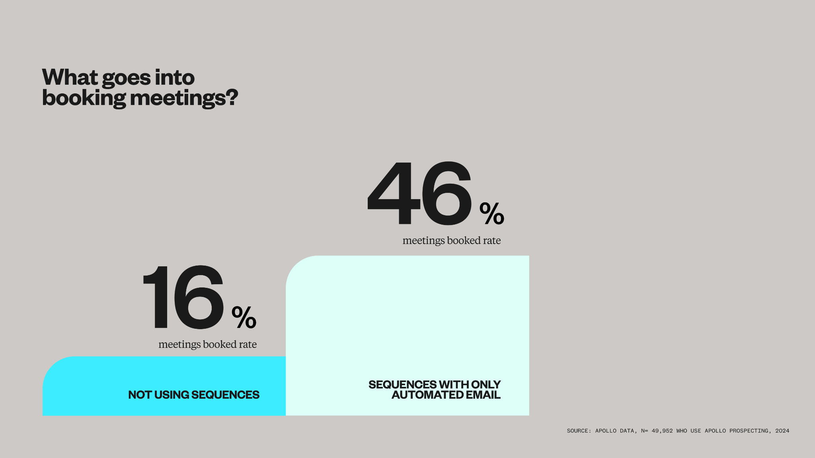
What goes into booking meetings?
* Top 1% of sellers
70% (4x)
meetings booked rate
Sequences with:
Automated email
Calls
Manual email
LinkedIn touches
Tasks
meetings booked rate
46% (3x)
16%
meetings booked rate
Sequences with only automated email
Not using sequences
Source: Apollo Data
Notes:
And we know what works. We’re sitting on a decade of GTM activity and can see what best practices are. In fact, in a study of almost 50K Apollo users, we found the best practices of what goes into booking meetings. We compared user groups across a 30 day period, to see who was best at booking meetings..
The people who only send out a single email, scatter shot, had the lowest meeting booked rate… only 16% of them are booking meetings
The people who at least create an email sequence, following up a couple times, half of them booked meetings.
The people who reach out and follow up across multiple channels book meetings 70% of them were booking meetings.
But we don’t gatekeep here. Our mission is to make GTM accessible for all. Because we know what works, we can use our AI platform to automate that for you

Slide 16
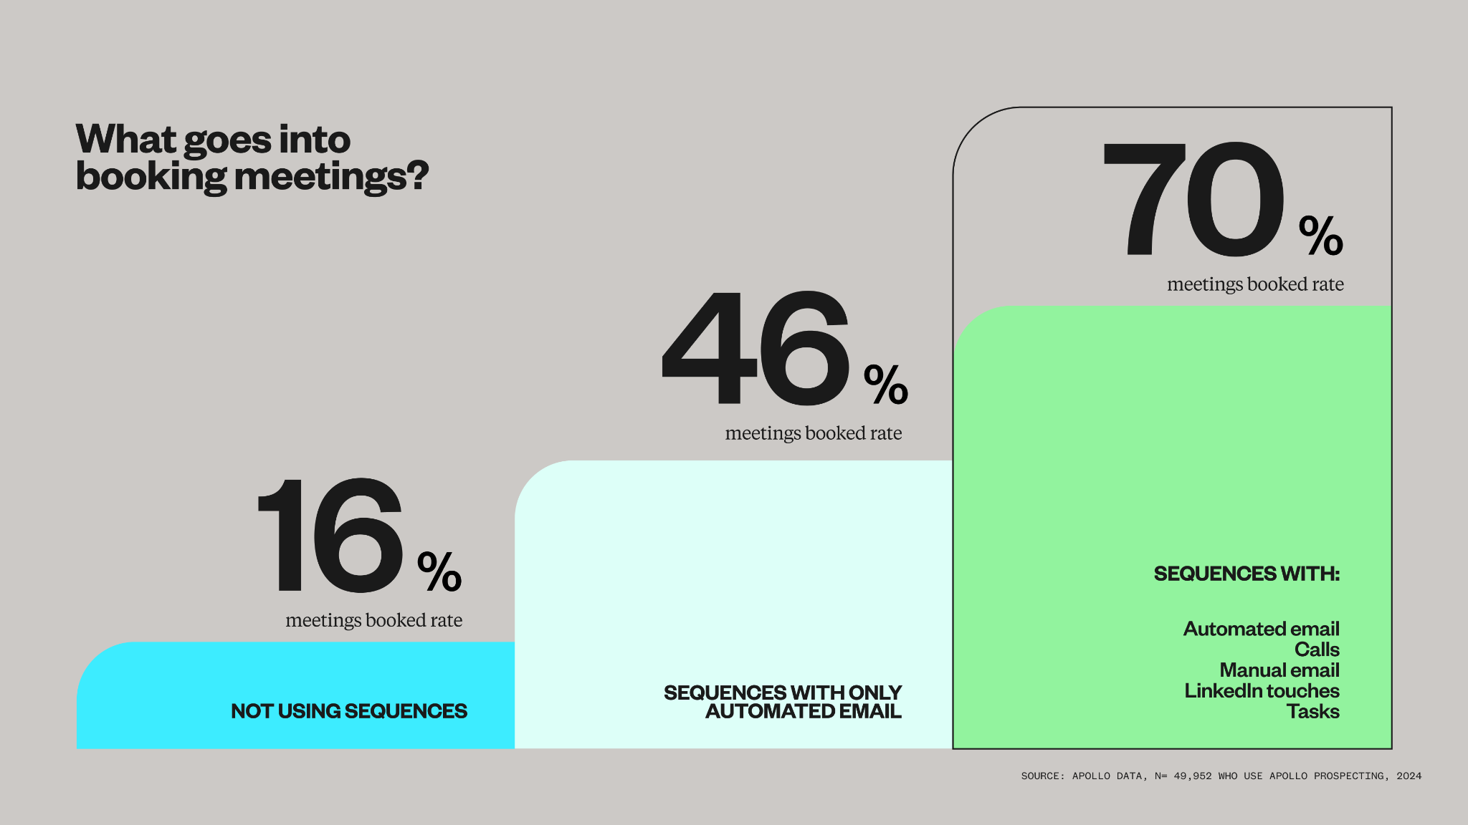
What goes into booking meetings?
* Top 1% of sellers
70% (4x)
meetings booked rate
Sequences with:
Automated email
Calls
Manual email
LinkedIn touches
Tasks
meetings booked rate
46% (3x)
16%
meetings booked rate
Sequences with only automated email
Not using sequences
Source: Apollo Data
Notes:
And we know what works. We’re sitting on a decade of GTM activity and can see what best practices are. In fact, in a study of almost 50K Apollo users, we found the best practices of what goes into booking meetings. We compared user groups across a 30 day period, to see who was best at booking meetings..
The people who only send out a single email, scatter shot, had the lowest meeting booked rate… only 16% of them are booking meetings
The people who at least create an email sequence, following up a couple times, half of them booked meetings.
The people who reach out and follow up across multiple channels book meetings 70% of them were booking meetings.
But we don’t gatekeep here. Our mission is to make GTM accessible for all. Because we know what works, we can use our AI platform to automate that for you

Slide 17
Demo: AI Assistant In Apollo
Chapter 3:
How to Book 2.3x’s Meetings in the First 14 Days
Notes:
JAMES - start screenshare

Slide 18
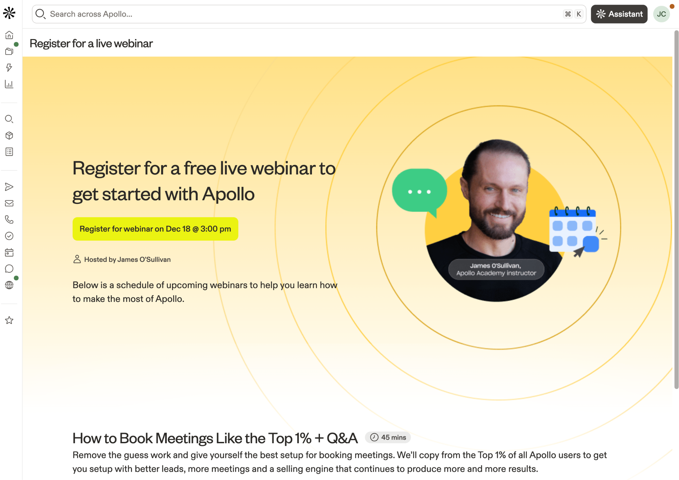
Join an Apollo training
How to Book 2.3x’s Meetings in the First 14 Days
Notes:
JAMES:
We do daily trainings including one on deliverability. Save the link in the Docs / Ticker.

Slide 19
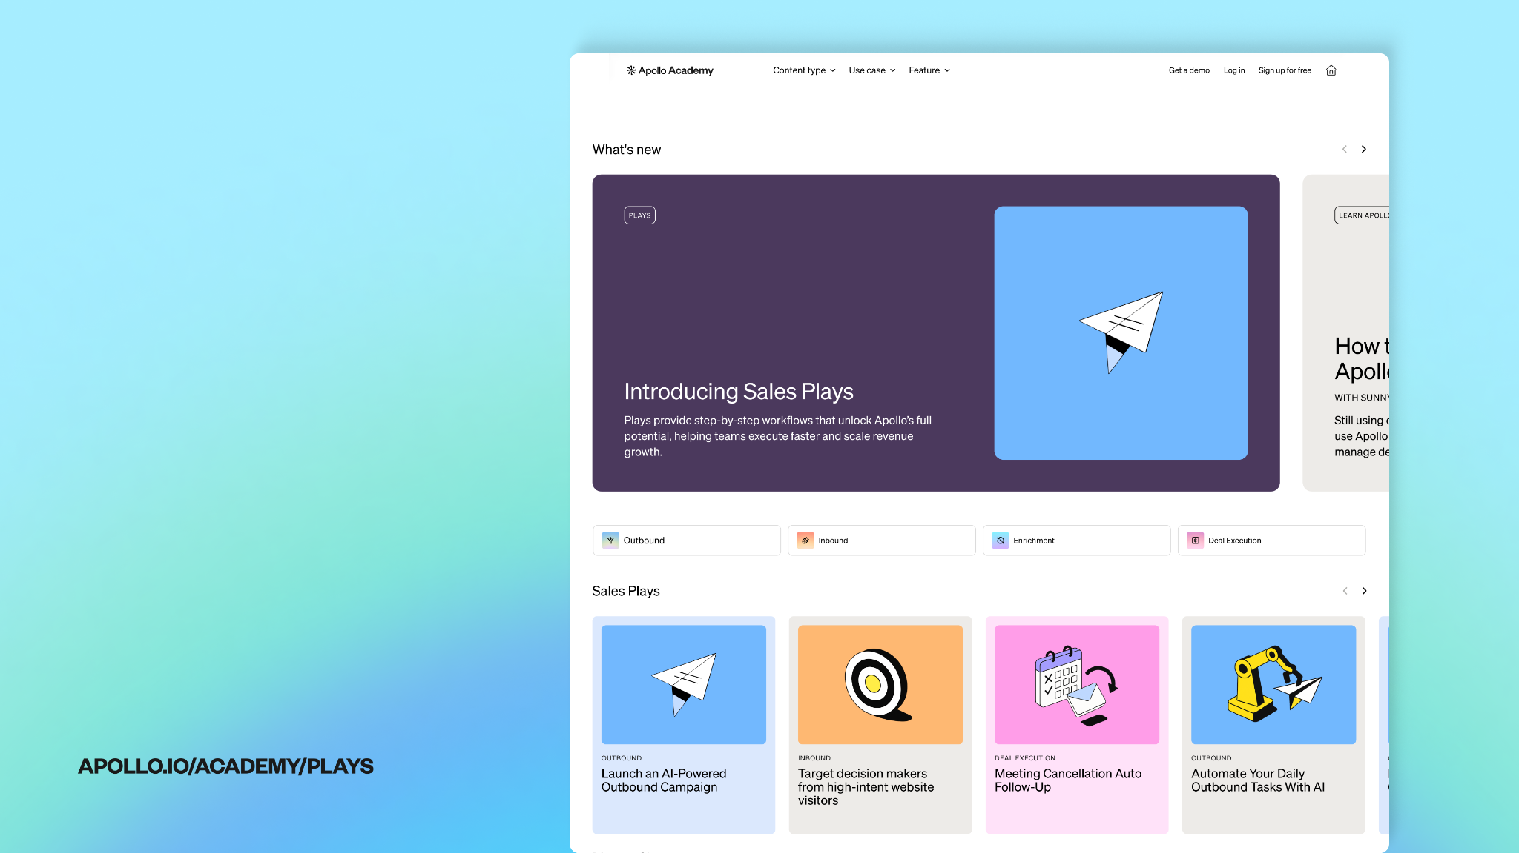
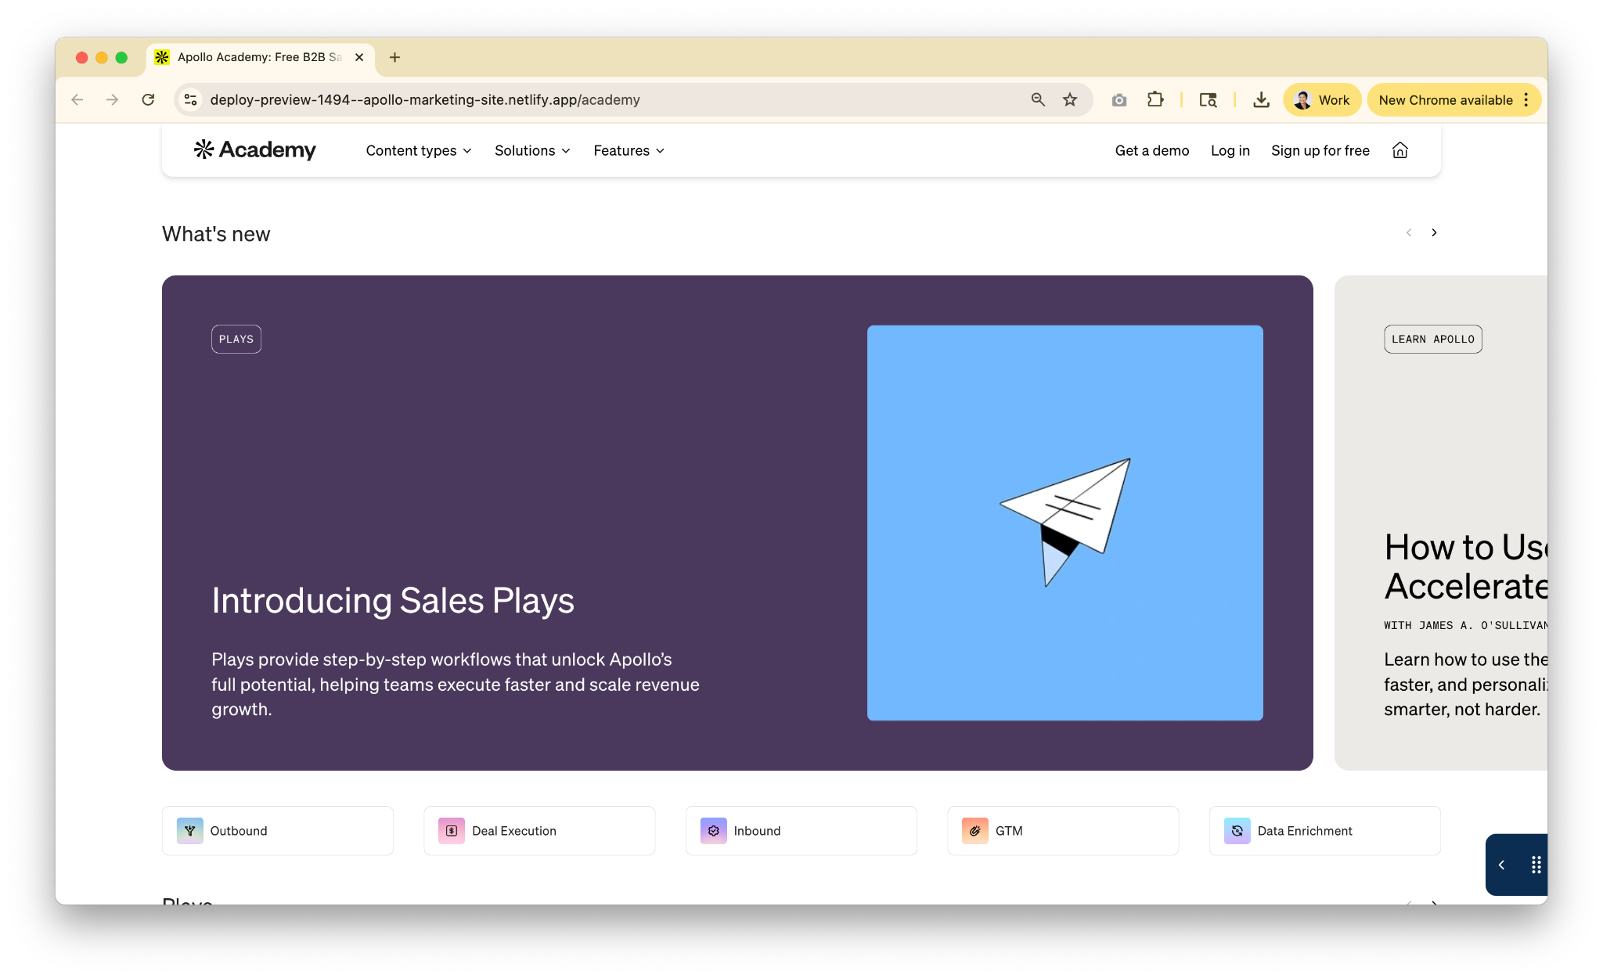
apollo.io/academy/plays
DESIGN DIRECTION:
Replace with screenshot of live Academy homepage (this is a screenshot of page on staging) with spotlight on the URL
Notes:
At Apollo, we’ve made it easy to grow your revenue faster. Everything I’m about to show you, you can do yourself through our new Sales Play library, released just today in the Academy. Here you’ll be able to find step by step plays and one-click workflow templates to get the most out of Apollo quickly, so you can spend more time focusing on hitting quota.

Slide 20
Want to speak Apollo’s sales team?
Request a demo
How to Book 2.3x’s Meetings in the First 14 Days
Notes:
James to call out POLL
Adji to launch POLL

Slide 21
Q&A
How to Book 2.3x’s Meetings in the First 14 Days
Notes:
James to moderate:
Welcome back Jeffrey to stage
What challenges with AI enrichment would you like us to cover during the live Q&A?
1. How can teams use AI enrichment to better define and find their ICP—especially when targeting very specific roles, industries, or niche markets?
[James] Use AI to help you write prompts, and test and refine your AI prompts to get the results you want.
2. What’s the best way to avoid signal overload and focus only on intent that actually matters?
[James] Understand your ICP deeply and when they might need your product & services, and focus on signals that ladders up to that.
3. What happens when different data sources return conflicting information, and how should customers think about trust and accuracy?
[Jeffrey] Data can be messy not only pertaining to Apollo > AI can hallucinate > Sporadic checks are important
4. How can customers reduce email bounces and spam issues when using enriched data? What role do validation and best practices play here?
[Jeffrey] Enabling 3rd party provider validation via waterfall is a great best-practice > improving bounce rates by 45%
5. What are examples of workflows that successfully remove manual work without disrupting sales reps’ day-to-day motion?
[James] Once personas are created, create a workflow to automatically enrich and add new contacts that match ICP into a list for reps to prospect.
Build out a sequence cadence you want you reps to follow for minimum prospect touchpoints and continuity.
Upload any messaging docs or email templates to content center that can feed the AI when reps writes emails

